Slide 1

Quantum CAPITAL LLC
ENERGY Fund Prospectus
“Driving capital markets through algorithmic design”

Slide 2

AGENDA
Introduction and Strategy
The Tools and Platform
The Data
The Models
The Strategy & Results
Conclusion

Slide 3
Introduction & Strategy

Slide 4


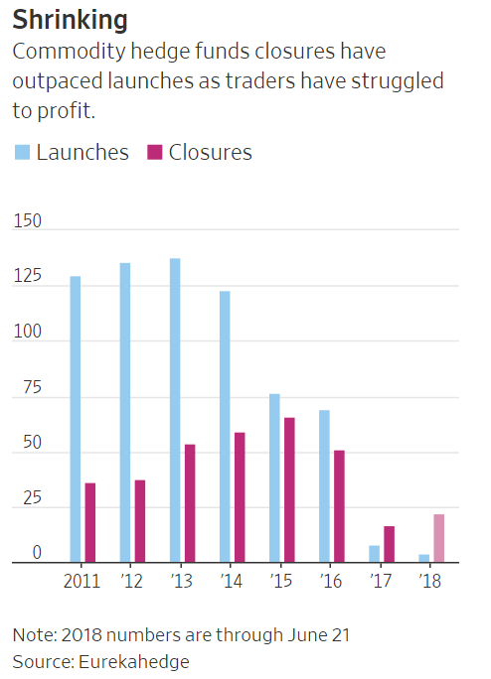
Slide 7
The Opportunity
In 2017, closures of commodities hedge funds outnumbered launches for the first time in data going back to 2000, according to data provider Eurekahedge—a trend that has continued into this year. The reason? Investors who were burned by the severe two-year market rout that started in 2014 aren’t rushing back, fund managers and traders say, despite prices of commodities, including oil, copper, lumber and cotton, all rebounding to multiyear highs.
BACKGROUND
Quantum Capital Management LLC is new private fund management company in fundamental commodity strategies with a specialization in the oil and energy complex. Quantum Capital is led by a team of data scientists. The investment strategy targets absolute returns with an asymmetric upside, via detailed supply and demand forecasting, fundamental, macro economic and physical market information combined with various technical market indicators to generate fair values, forecasts and trading signals for energy and commodities.
~ 5 Years
The Challenge
of Data
Extract insights from over a 1000 separate data sources consisting of 5 years of data and over 4000 variables. Data sources include: Department of Energy, Chicago Mercantile Exchange and various Global Indexes
The data is both unstructured and structured to fit into a data warehouse.
4000+
Variables

Slide 5

KEY characteristics of our strategy.
Story: Identify key signals in scenarios that correlate strongly with the probability that the market has continuously mispriced futures prices in these situations, creating opportunities to earn market returns but with significantly less risk.
Process:
Download, track and store activity in an energy sector
Apply various data munging and feature extraction techniques
Fit various algorithms and machine learning techniques on the data sets.
Back test strategy and forecast result
Returns: Working in a team of 4 using two portfolio strategies with $20 million in capital, we would like to averaged 11% annual returns, always in a relatively narrow band from 8% to 15% in any given year.

Slide 6
The Tools and Platform

Slide 7


Build a platform for analytics at scale….
Data Transformation
User-Defined Functions
BI & Visualization
SQL
R
Java
C++
Python
Geospatial
Real-time
Text Analytics
User-Defined Loads
ODBC JDBC OLEDB
Streaming
Event Series
Pattern Matching
Time Series
Machine Learning
Regression
User-Defined Storage
ETL
Security
External Tables: Analyze in Place

Slide 8

….robust computational platform
Data Analysis
Data Preparation
Modeling
Evaluation
Deployment
• Statistical Summary
• Time Series
• Sessionize
• Pattern Matching
• Date/Time Algebra
• Window Partition
• Sequences
• And more…
• Outlier Detection
• Normalization
• Imbalanced Data
Processing
• Sampling
• Missing Value
Imputation
• And More…
• SVM
• Random Forests
• Logistic Regression
• Linear Regression
• Ridge Regression
• Naïve Bayes
• Cross Validation
• And More…
• Model-level Stats
• ROC Tables
• Error Rate
• Lift Table
• Confusion Matrix
• R-Squared
• MSE
• And More…
• Deploy Anywhere
• In Database Scoring
• Massively Parallel Processing
• Speed
• Scale
• Security
• And More…
Notes:
Swap Analysis and Prep?

Slide 9
Data Preparation and Final Set

Slide 10
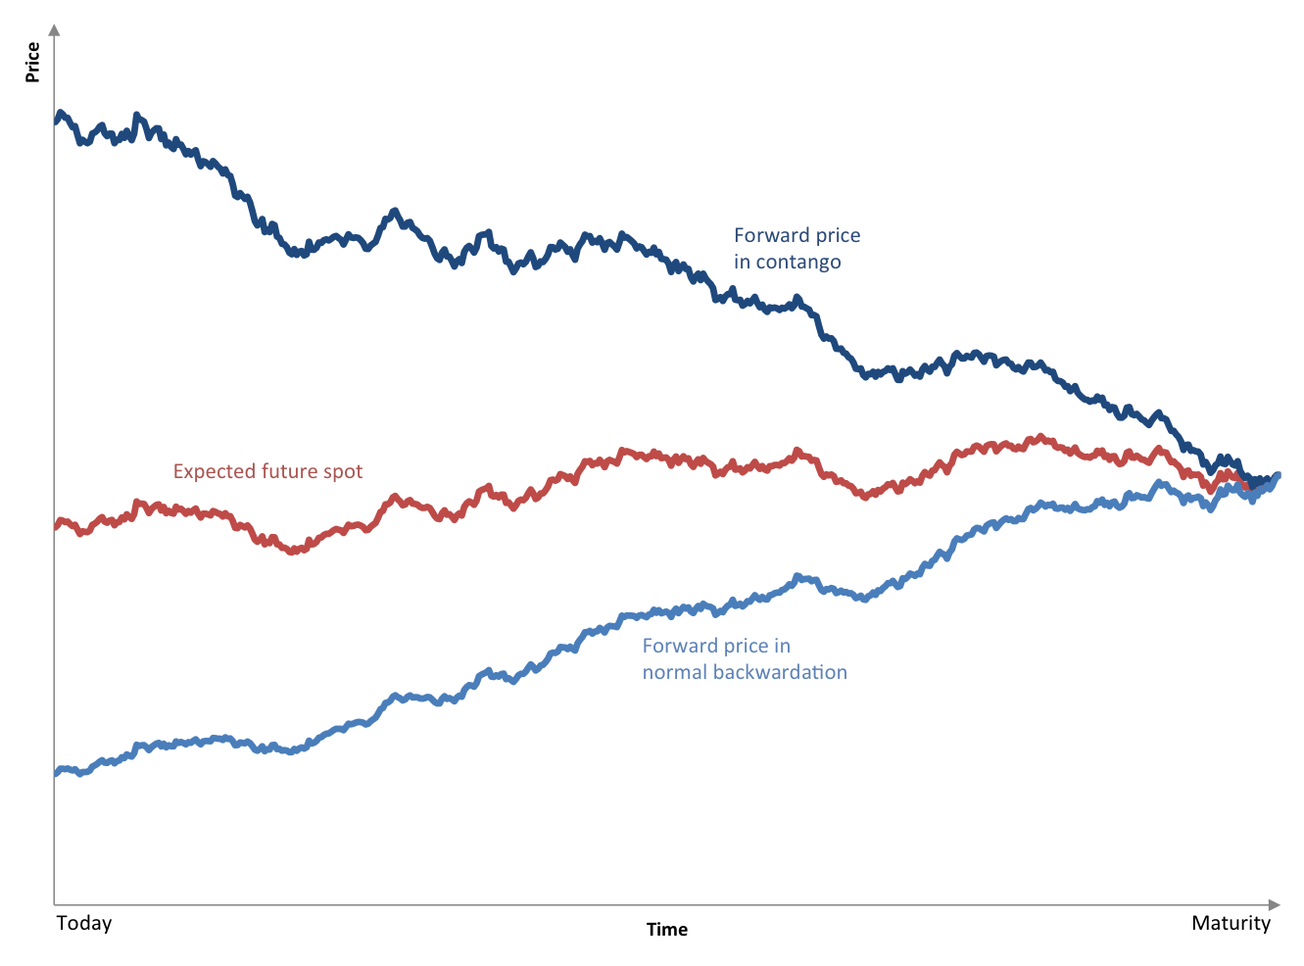
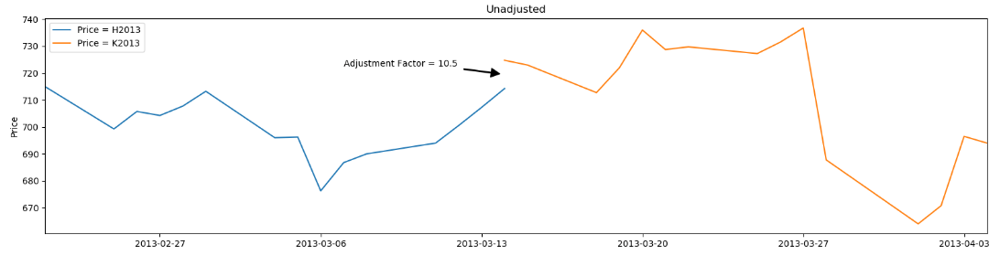
Forming a Continuous Futures Contract
The main difficulty with trying to generate a continuous contract from the underlying contracts with varying deliveries is that the contracts do not often trade at the same prices. Thus, situations arise where they do not provide a smooth splice from one to the next. This is due to contango and backwardation effects.
Here is another view of a March delivery contract rolling over to April – Price versus Time

Slide 11
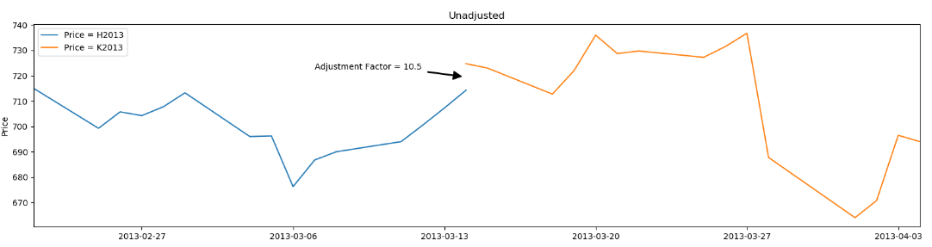
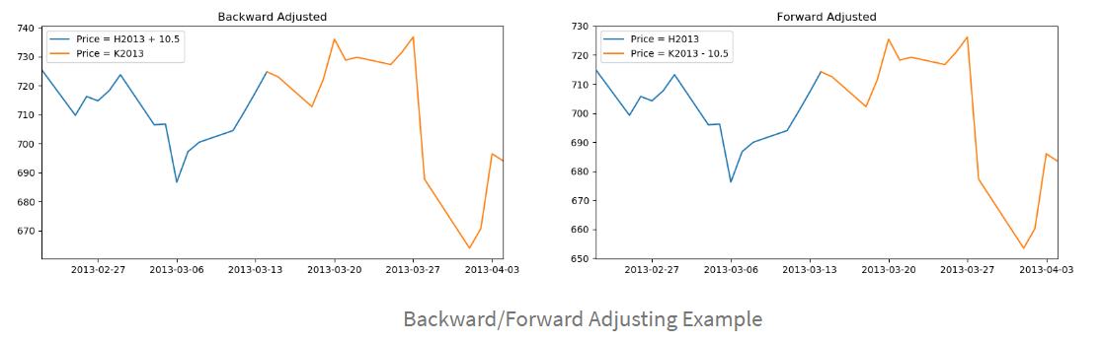
Forming a Continuous futures contract(Continued)
This is the easiest to understand, Back/Forward Adjustment
The key problem with these methods includes the introduction of a trend bias, which will introduce a large drift to the prices. This can lead to negative data for sufficiently historical contracts. In addition there is a loss of the relative price differences due to an absolute shift in values. This means that returns are complicated to calculate (or just plain incorrect).

Slide 12
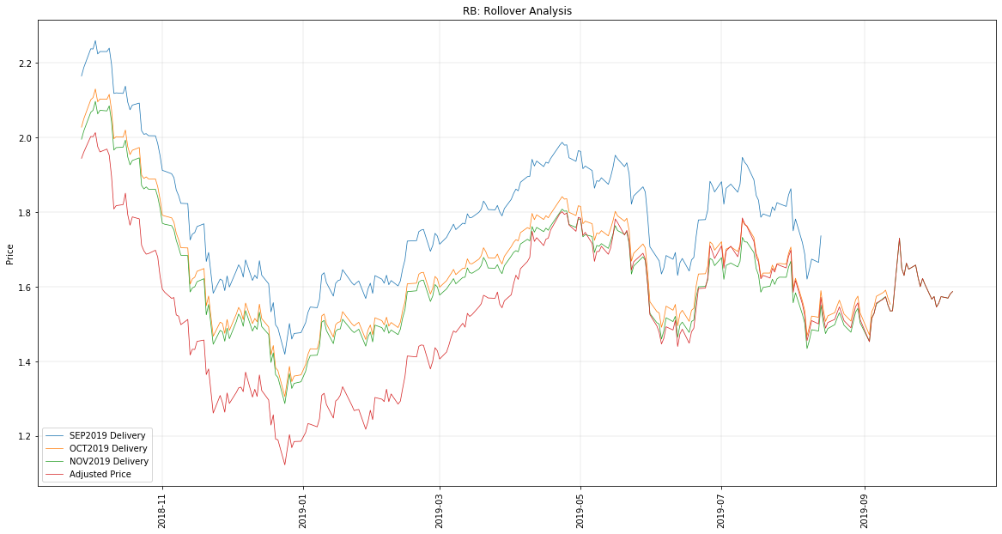
Forming a Continuous futures contract(Continued)
The gasoline contract adds another wrinkle to the creation of a continuous contract. There are two blends, one summer(April-September) and the other winter(October – March) which differ in price because of production costs.
We will be using the Perpetual Series approach to create a continuous contract of successive contracts by taking a linearly weighted proportion of each contract over a change in open trading interest to ensure a smoother transition between each. We will concentrate on implementing the perpetual series method as this is most appropriate for backtesting.

Slide 13
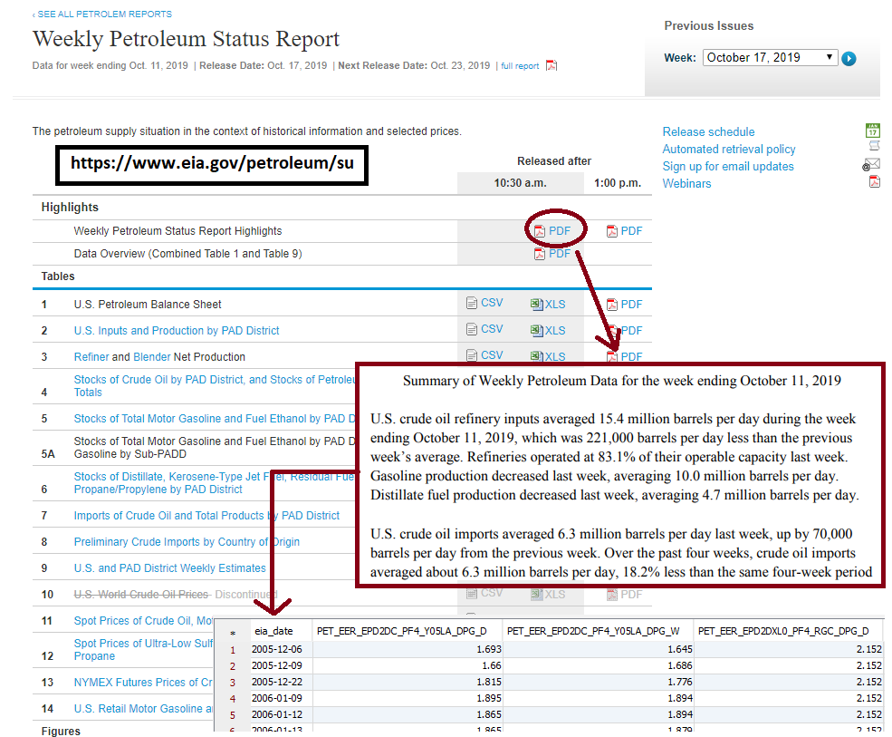
Department of energy weekly report data
Downloaded and stitched together weekly petroleum data from EIA website into usable format for modeling.

Slide 14
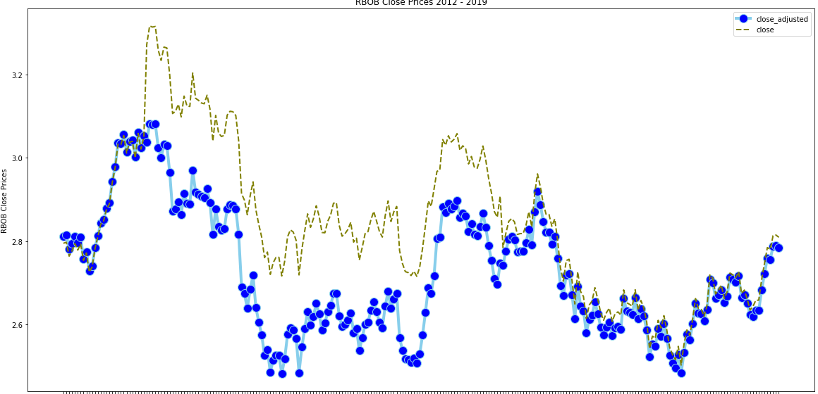
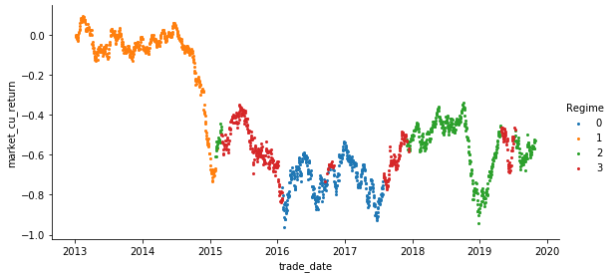
C# Application DEMO

Slide 15
Modelling and Solution Overview

Slide 16

Trade Modeling Process Flow
We will need $22 million in cap ex funds for this project to deliver the initial phase of this project.
Statistical Summary
Neural Network
ROC Tables
Time Series
Outer Detection
Lift Table
Dashboard
Development
Random Forests
Normalization
Confusion Matrix
Pattern Matching
Mobile Application Development
Logistic Regression
R-Squared
Date Type Handling
Missing Value Imputation
Linear Regression
MSE
Data Collection
Data Analysis & Understanding
Data Preparation
Modeling
Evaluation
Visualization
This will be an iterative process.

Slide 17
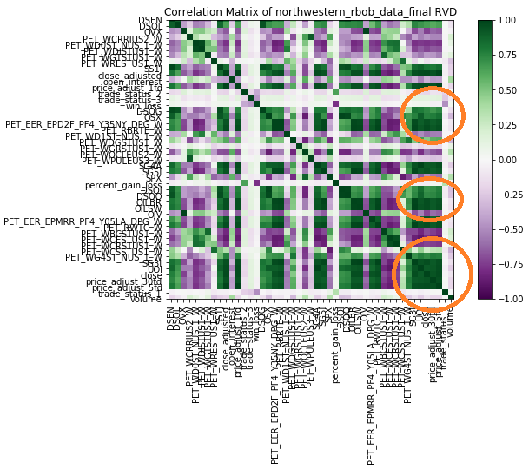
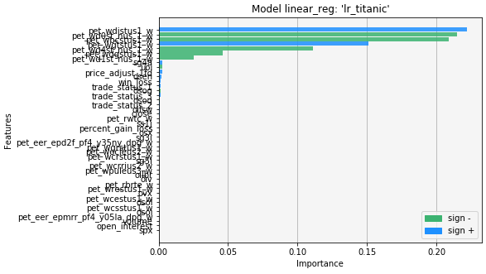
Initial Visual of the Data set
We examine the correlation between all the attributes as the first pass of analysis. We can clearly see clusters of attributes that are highly correlated. We quickly call the linear regression function and produce an initial model to examine the statistics. We form a visual graph of the most important features seen below;

Slide 18
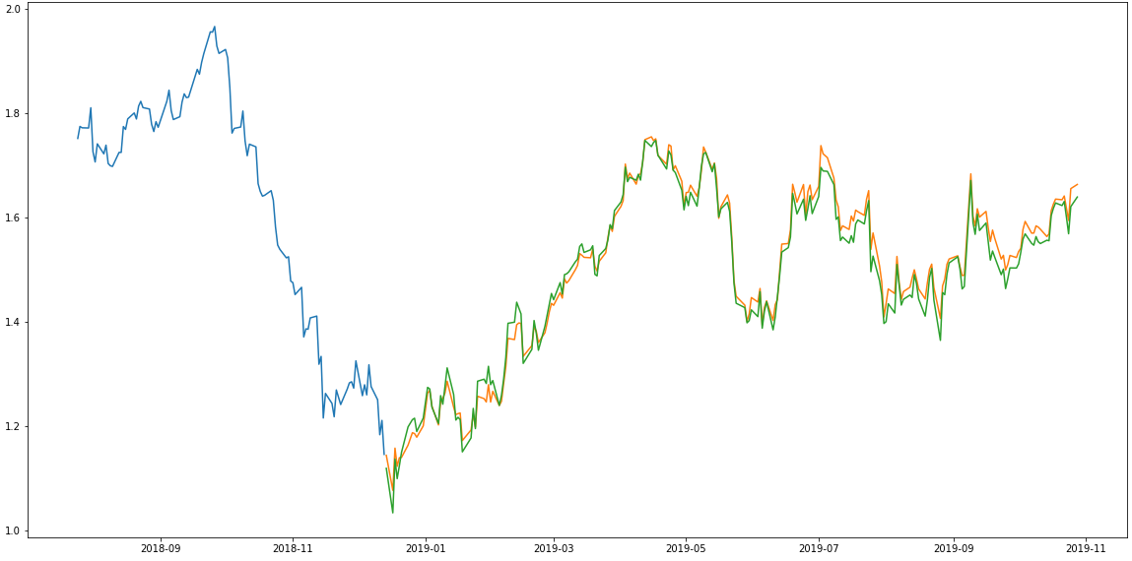
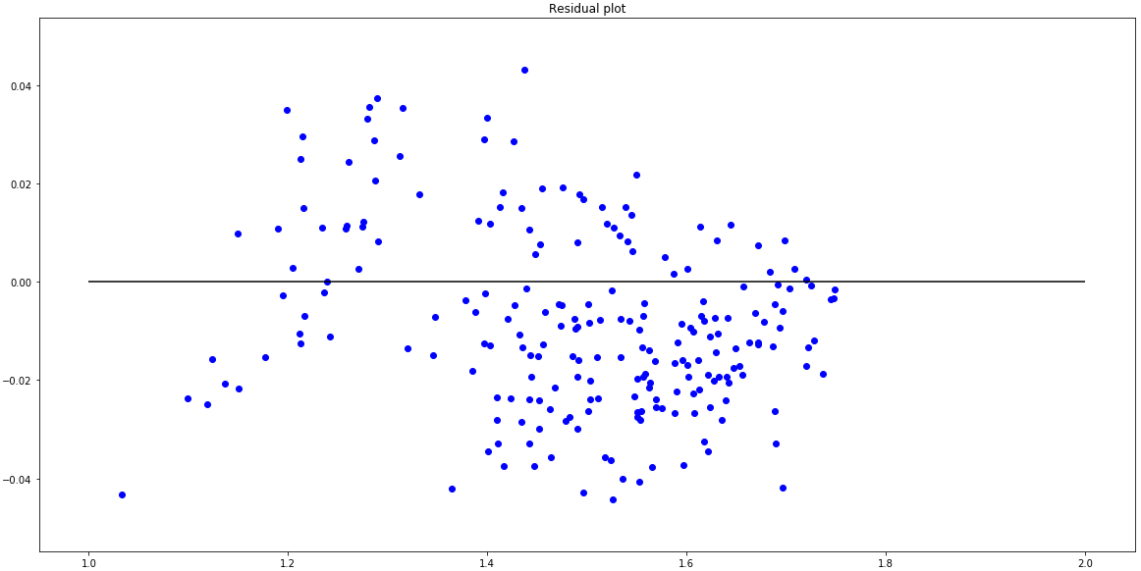
Linear Regression Model Summary
We analyzed several linear models; Linear Regression, Polynomial, Ridge and Lasso.
All these models had a RSquared >98% and MSE ~0.00.
We have discussed Linear regression and Polynomial introduces a more controlled fit depending on the degree put into the model. Ridge and Lasso regression uses two different penalty functions. Ridge uses l2 where as lasso go with l1. In ridge regression, the penalty is the sum of the squares of the coefficients and for the Lasso, it’s the sum of the absolute values of the coefficients. It’s a shrinkage towards zero using an absolute value (l1 penalty) rather than a sum of squares(l2 penalty). Ridge regression can’t zero coefficients. You either select all the coefficients or none of them whereas LASSO does both parameter shrinkage and variable selection automatically because it zero out the coefficients of collinear variables.
Error residual looked good…
Actual versus predicted prices where quite similar.

Slide 19

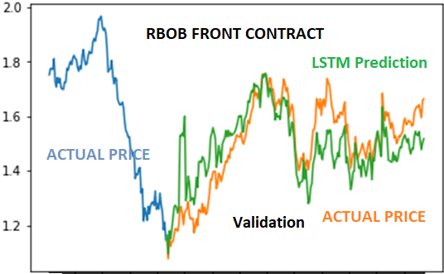
Deep Learning Discussion

Slide 20
Strategy Results

Slide 21
Trading Strategy overview
Using our model predicted data, our trading strategy is simple: we look for peaks and troughs in the returns, areas that are relatively large outliers.
The idea is that because we have created a stationary time-series using multiple asset returns, when one returns take a sharp up/down-turn, we enter the position (the direction is the opposite from the sign of the predicted return: positive, we sell, negative we buy).
Since there is a statistically significant autocorrelation at a given lag interval, we will take the inverse side and close out our position in x trading days from entry (determined by strategy).

Slide 22
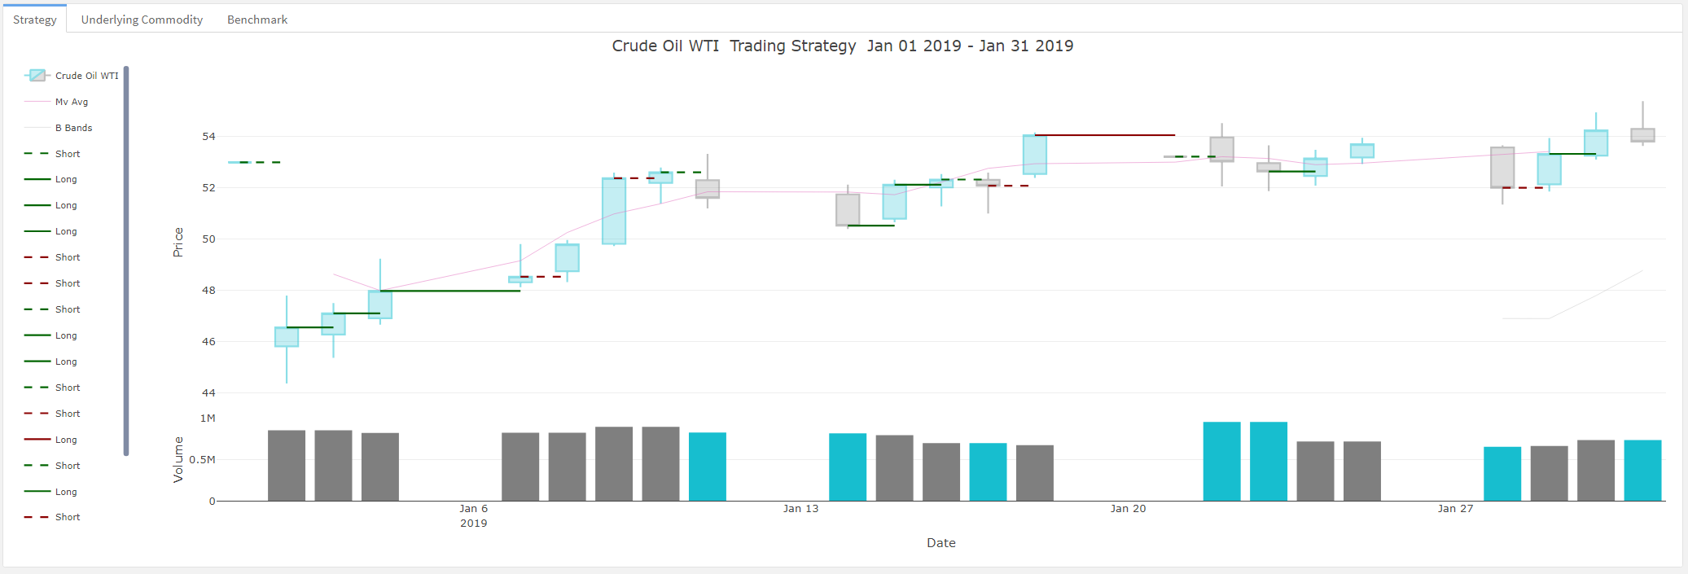
Strategy execution: Deep dive
As an example of the strategy in action, multiple positions were entered over the period in January 2019.
The line representing the position is through its entire holding period, and its colored green if it made money, or red if it lost money.
Solid Lines | Long Position (buy low -> sell high)
Dashed Lines | Short Position (sell high -> buy low)
We enter in the position on 1/1 with a sell-short on WTI Crude at $52.98, and then issued a cover short to close out our position at $46.56, yielding a net profit of $6.44 per barrel. Assuming 44,000 barrels per contract, this transaction netted our portfolio a gross profit of $241,120, or a 12.1% return on invested capital.

Slide 23
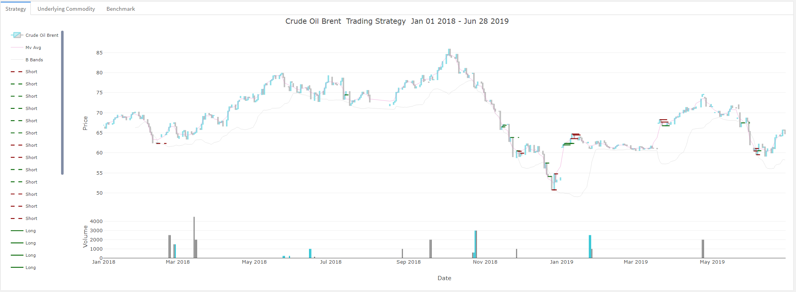
TRADING STRATEGY AND PERFORMANCE Crude Oil Brent
With a low trading threshold from the models predicted values, and a short-period, explosive volatility time series, the resulting strategy is one with a 1 day holding period per transaction. The annualized return on the strategy is 29.27%, resulting from 97 holdings over the period.

Slide 24
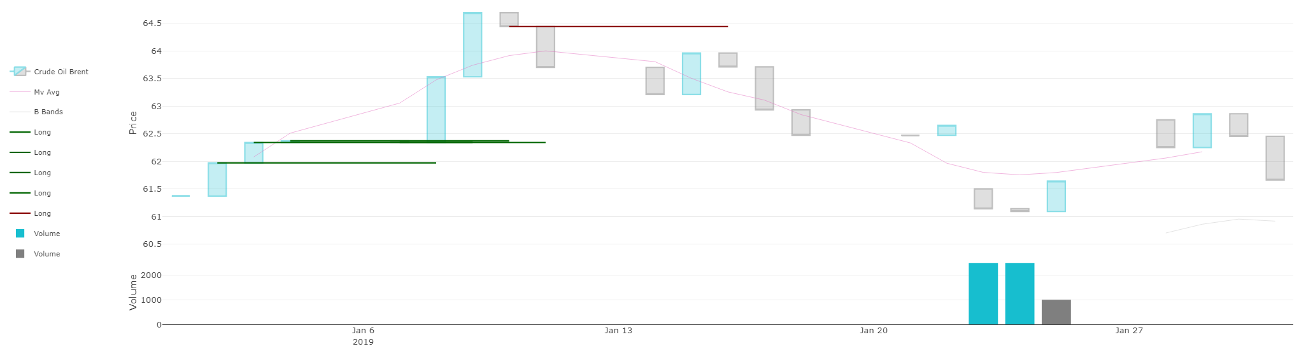
strategy Summary performance
Data pre-processing, normalization and augmentation.
Risk profiles for each of the various assets & corresponding parametric model estimates.
Preliminary time series analysis & statistical correlations for Crude products
A predictive model for WTI, and corresponding trading strategy (mean-revision).
Initial backtest results yield net positive PnL and returns for the testing period (2019).
WTI mean revision strategy performance is 22.39% annualized returns.
The trade execution / PnL dashboard is functional locally.
Crude Oil Brent – 1/1/19 – 10/30/19
Commodity | Strategy | Benchmark
13.45% | 16.8% | 3.74%
17.94% | 22.4% | 4.99%
Crude Oil - Brent
Periodic
Annualized

Slide 25
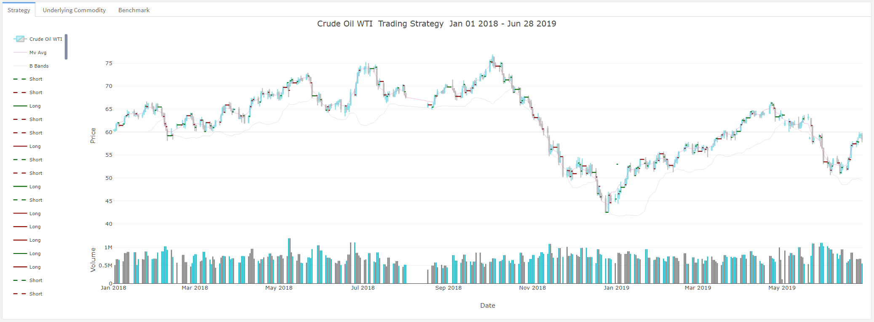
strategy performance Crude Oil WTI
Year to date in 2019, our testing data range, we issue exactly 16 positions (32 transactions), leaving us with a net zero position at the end of the holding period, for an annualized return of 35.81%.

Slide 26
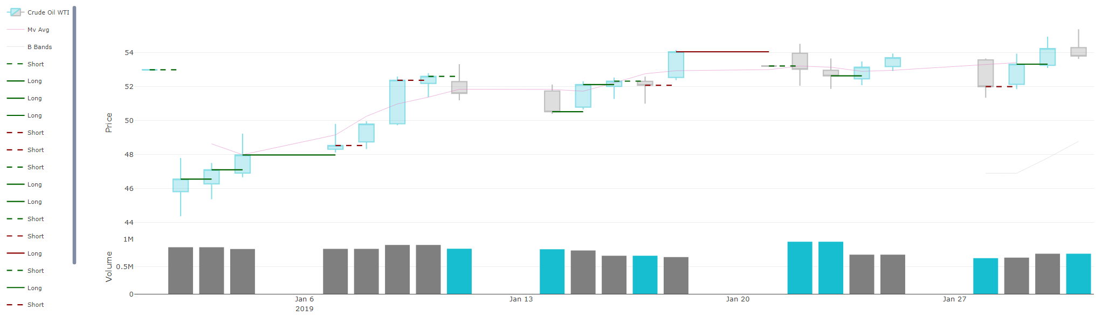
strategy Summary performance
Data pre-processing, normalization and augmentation.
Risk profiles for each of the various assets & corresponding parametric model estimates.
Preliminary time series analysis & statistical correlations for Crude products
A predictive model for WTI, and corresponding trading strategy (mean-revision).
Initial backtest results yield net positive PnL and returns for the testing period (2019).
WTI mean revision strategy performance is 26.11% year to date.
The trade execution / PnL dashboard is functional locally.
Crude Oil WTI – 1/1/19 – 10/30/19
Commodity | Strategy | Benchmark
23.1% | 26.11% | 3.74%
30.8% | 34.81% | 4.99%
Periodic
Annualized

Slide 27
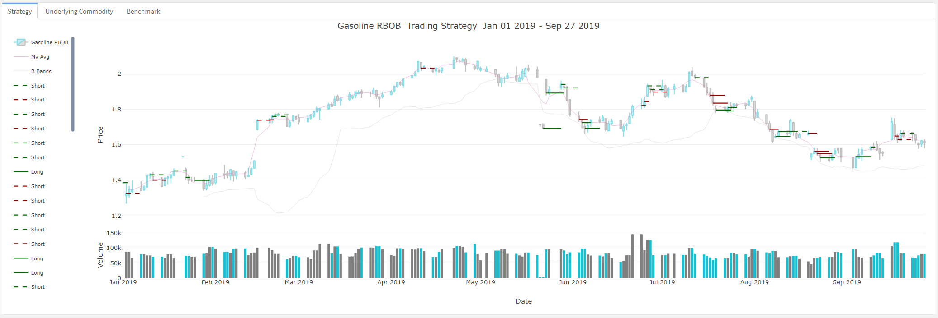
TRADING STRATEGY AND PERFORMANCE Gasoline
With a low trading threshold from the models predicted values, and a short-period, explosive volatility time series, the resulting strategy is one with a 3-day holding period per transaction. The annualized return on the strategy is 58.45%, resulting from 76 holdings over the period.

Slide 28
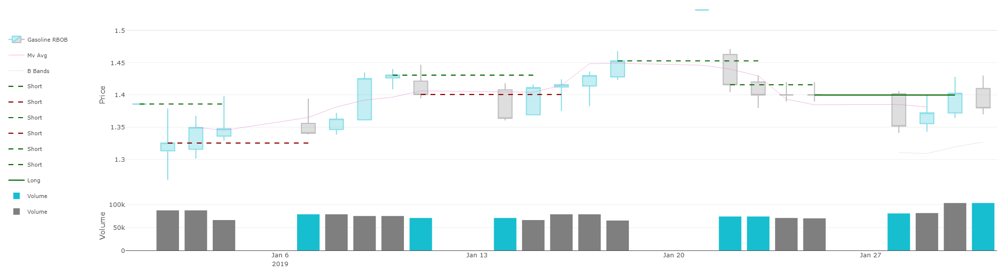
strategy Summary performance
Data pre-processing, normalization and augmentation.
Risk profiles for each of the various assets & corresponding parametric model estimates.
Preliminary time series analysis & statistical correlations for Gasoline products
A predictive model for Gasoline, and corresponding trading strategy (mean-revision).
Initial backtest results yield net positive PnL and returns for the testing period (2019).
WTI mean revision strategy performance is 29.27% annualized returns.
The trade execution / PnL dashboard is functional locally.
Gasoline – 1/1/19 – 10/30/19
Commodity | Strategy | Benchmark
23.8% | 43.85% | 3.74%
31.8% | 58.45% | 4.99%
Periodic
Annualized

Slide 29
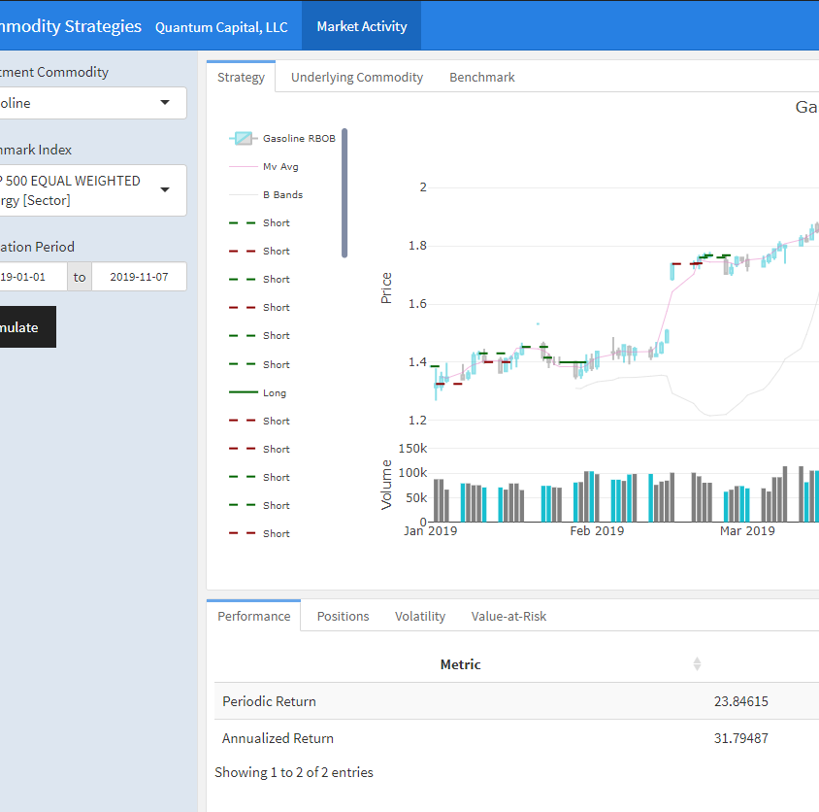
Interactive dashboard
See our strategies in action, visit our live dashboard and see how we perform.

Slide 30
Conclusion

Slide 31




team
Andrius Markvaldas
Joshua Wood
Brandon Moretz
Tate Bollick
Has over 20 years of information technology and data management experience on a variety of different platforms. He defined enterprise data strategies, as well as, built and managed world-class data capabilities for proprietary trading firms.
Flew for Southwest Airlines as captain of a Boeing 737 before turning to finance. His attention to detail, situational awareness and self-confidence rounds out the team dynamics.
Has close to two decades of experience in the financial services industry. Most recently heading the development efforts of a proprietary in-house order management, research and risk analytics systems for a hedge with $20B in assets under management. Before that he spent time in the anti-money laundering space for some of the world’s largest financial institutions.
For over 10 years, Tate has held a variety of roles within finance and technology. He has spent the last six years in program and project management for medium and large scale financial institutions. During that time he has worked on number of different projects for front, middle, and back office functions. He received his MBA in 2014, and has lived in Charlotte, NC since then.

Slide 32
Solution Overview
Explore
Explored multiple data sources from exchanges to government web sites.
Download data from paid and unpaid sources.
Analyze
Analyzed important predictors and extracted key features to predict loan default
Deploy
C# Application for Pattern Search
Dashboard CEO Mobile Application
Top Model: Mean Reversion Strategies using GARCH
Evaluate different platforms and technologies.
Understand Energy Market Sector and more importantly the volatility associated with it.
Dashboard and Mobile App
Final DataSet:
5 Years of Data and 89 Predictors
Prepare
Model
Consolidated data sources , imputed missing values, transformed outliers and skewed variables, created derived variables.
Built several models: Linear Regression(Polynomial, Ridge and Lasso)
Gaussian Mixed Mixture
ARIMA
GARCH
Random Forest
XGBOOST
Deep Learning(RNN-Tensor)

Slide 33
strategy Summary performance
Crude Oil WTI – 1/1/19 – 10/30/19
Data pre-processing, normalization and augmentation.
Risk profiles for each of the various assets & corresponding parametric model estimates.
Preliminary time series analysis & statistical correlations for Crude products
A predictive model for WTI, Brent, Gasoline and corresponding trading strategy (mean-revision).
Initial backtest results yield net positive PnL and returns for the testing period (2019).
WTI mean revision strategy performance is 26.11% year to date.
The trade execution / PnL dashboard is functional locally.
Commodity | Strategy | Benchmark
23.1% | 26.11% | 3.74%
30.8% | 34.81% | 4.99%
Periodic
Annualized
Crude Oil Brent – 1/1/19 – 10/30/19
Commodity | Strategy | Benchmark
13.45% | 16.8% | 3.74%
17.94% | 22.4% | 4.99%
Crude Oil - Brent
Periodic
Annualized
Gasoline – 1/1/19 – 10/30/19
Commodity | Strategy | Benchmark
23.8% | 43.85% | 3.74%
31.8% | 58.45% | 4.99%
Periodic
Annualized

Slide 34
Thank you!
Feel free to contact any one of us…..

